Slide 1
Mushroom Classification using Random Forest

Slide 2
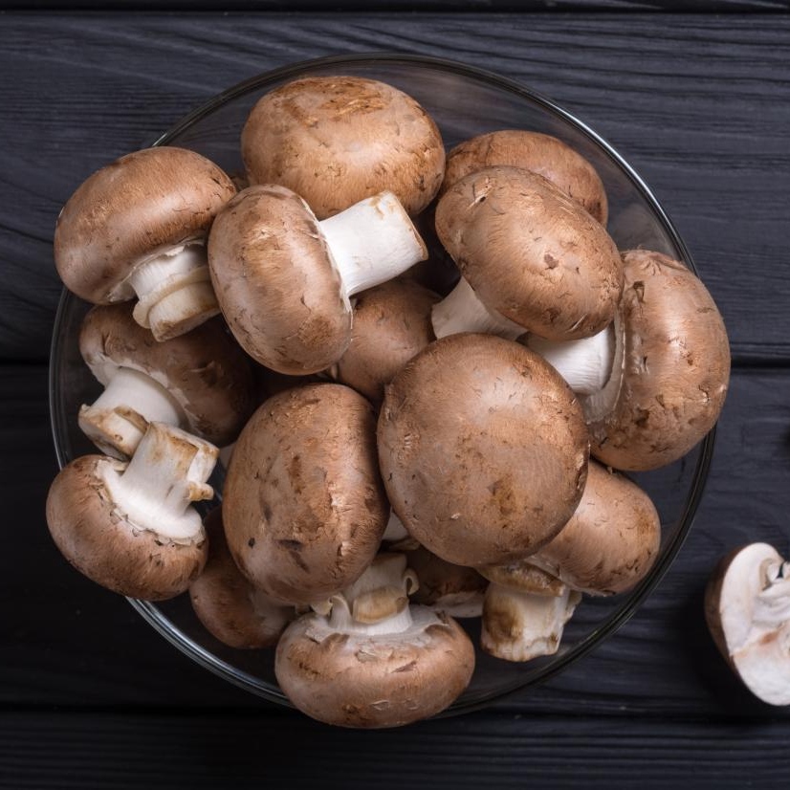
Group Members
AM.EN.U4AIE21113 Ananthakrishnan
AM.EN.U4AIE21173 Mridul Sharma
AM.EN.U4AIE21129 Gautham Krishna Priya AM.EN.U4AIE21135 K Bharadwaj
AM.EN.U4AIE21162 Surya Vamsi Vema
AM.EN.U4AIE21175 Kiran P
Notes:
© Copyright Showeet.com – Creative & Free PowerPoint and Google Slides Templates

Slide 3
INTRODUCTION
There are approximately 2.2 to 3.8 million species of mushrooms worldwide. Out of which 18,000 species of mushrooms are scientifically classified and it is estimated that there are over 5000 out of these 18,000 classified mushrooms which are toxic and thus can harm the person who consumes it.
As a result mushroom poisoning is a major health challenge in most rural areas of the world. There are a large number of people who consume toxic mushrooms unknowingly causing food poisoning and in worst cases even death of that person.
So, it becomes important to know what we are eating. Therefore in our project we used machine learning to helps us to find whether a mushroom is edible or poisonous.
This project contains the source code, its explanation and dataset for a machine learning algorithm that classifies mushrooms as edible or poisonous based on its features. With this we can reduce the risk of someone consuming poisonous mushrooms and can identify quickly whether a mushroom is edible or not.
(Note) The Machine Learning models shown in this project is created for educational purposes and must never be used to identify a species as edible or poisonous in real life settings
Notes:
© Copyright Showeet.com – Creative & Free PowerPoint and Google Slides Templates

Slide 4
Problems and Challenges
With all the different types of mushrooms in the world and many of them being poisonous, it is necessary to be able to classify them as edible or poisonous. But since there is no hard and fast rule with which we can identify the mushrooms toxicity based on physical traits, we can only make guesses based of our knowledge and experience with mushrooms. Another method would be to use a machine learning algorithm to train a model that can classify edible mushrooms as edible and poisonous to certain level of accuracy.
To do that we use a UCI repository that has more than 8000 records of mushrooms with their different features and their classification as edible or poisonous. There are also code available online for training machine learning models with the given Dataset.
But the Reference for the Code just included splitting the Database for just training, testing and measuring the accuracy of the model. However, this is not useful for classifying real mushrooms as we cannot convert the categorical values of features of the mushrooms to the same ordinal values that the features in the dataset was converted to for training the model. Moreover the model initially was trained to classify based on 22 different features in a mushroom and identifying all of them from a real mushroom is extremely hard and can result in miss-identification causing the model to give wrong classifications.

Slide 5
Solution Approach
The machine learning algorithm we are choosing for the project is Random Forest. Random forest was chosen due to its high accuracy for classifying data.
Initially the dataset we have is split into two parts for training and testing the machine learning model in 80:20 proportion respectively. The model is trained with all the features of the mushroom present in the dataset and is tested for its accuracy. We get a great accuracy of 100%.
To solve the problem of not being able to accurately get all the features of a mushroom to classify it in real life, we check the feature importance of the first model and we select 5 of the most important and easily identifiable features of the mushroom based on the feature importance graph to train the second model on to classify real mushrooms.
To solve the problem of converting categorical values of the features of mushrooms to ordinal for classifying it, we create a mapping of all the converted categorical values to their ordinate counterparts and store in a variable. When it is time to classify real mushrooms, we can use this mapping to convert their categorical features to the same ordinal values that the model was trained on using the mapping.
We are using python to implement Random forest approach in our source code. The modules being used from python in this project are given below.

Slide 6

Design Aspects
Visual Studio Code was used to write the python source code for this project .
GitHub/Git was used for collaborating the code and other
details of the project online and as version control. Google Collab is used for explaining
the different parts of source code.
Python scikit-learn machine learning library was used for implementing the machine learning
model, testing its accuracy and for data preprocessing.
The different Python modules used in this project are given below.
import pandas as pd
import matplotlib.pyplot as plt
import numpy as np
import pprint
from sklearn.model_selection import train_test_split
from sklearn.preprocessing import LabelEncoder
from sklearn.ensemble import RandomForestClassifier

Slide 7

Data And Validation
The necessary dataset for the training of the model was taken from here that mentions the source of this dataset as Mushroom records drawn from “The Audubon Society Field Guide to North American Mushrooms (1981). G. H. Lincoff (Pres.), New York: Alfred A. Knopf” .
Data from the dataset is read using read_csv() function in panda module in python:
This real world data but still may contain noises, missing values or maybe the data could be in an unusable format which cannot be directly used for machine learning models. The random forest algorithm is designed in such a way that it can handle missing values. Data preprocessing is a set of tasks which are done for cleaning data and making it suitable for a machine learning model which also increases the accuracy and efficiency of a machine learning model.
pd.read_csv("mushrooms.csv")

Slide 8
IMPLEMENTATION
In this Project we are using a dataset named “mushrooms.csv”. The Python source code,the mushrooms.csv dataset and other files can be found in the GitHub Link Given below:
GitHub
The Github repository contains two separate Python files. One for the first model in which all the features are used and to find the feature importance. Second Python file contains the code for the model which we can use to classify real mushrooms.
The detailed explanation and implementation of the code is given as a Jupyter notebook in the Google Collabaratory link given below:
Google Collab
This project specifically uses the random forest approach for classifying mushrooms .
Random forests or Random decision forests are an ensemble learning method for classification, regression and other tasks that operates by constructing a multitude of decision trees at training time.
The Steps for implementation include:
Data Pre-processing
Spliting the Data into training and testing sets.
Fitting the Random forest algorithm to the training set.
Test Accuracy of the Result
Visualizing the test result.
Notes:
© Copyright Showeet.com – Creative & Free PowerPoint and Google Slides Templates

Slide 9
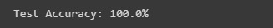
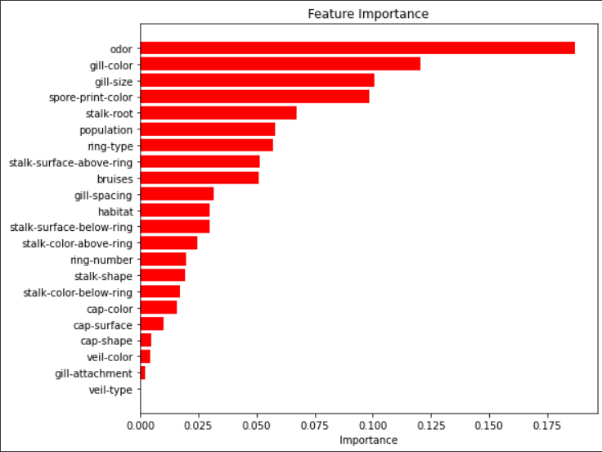
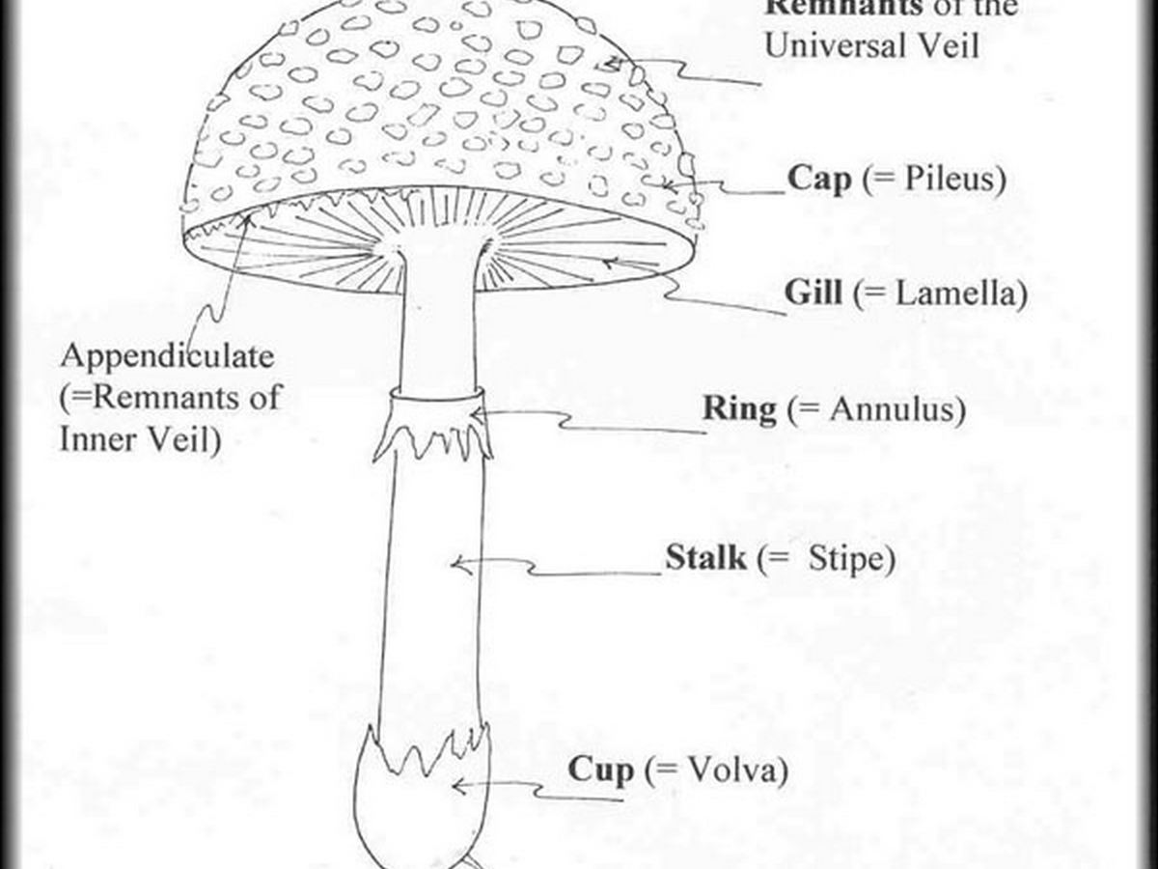
Firstly we train the model for identifying mushrooms using all 23 features given in the dataset and test its accuracy
The model gives a test accuracy of 100% but in real life situations , It will be exponentially hard for an individual to search and identify all these different traits of a mushroom and its also time consuming. So To create a concise yet accurate model , the model was trained again but this time using some of the features only but those features that have high importance and is easily identifiable among all features so that we get the most accurate prediction.
According to this Graph we choose the most important traits
of mushrooms which help us to predict whether or not
it is edible.

Slide 10
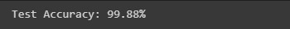
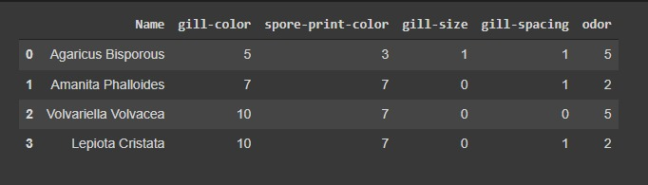
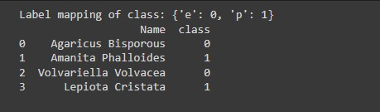
The new model trained on selected features has good accuracy and can be tested on real mushrooms.
The following mushrooms were selected to test against the model to ensure it works properly-
Agaricus Bisporous - Edible
Amanita Phalloides - Poisonous
Volvariella Volvacea - Edible
Lepiota Cristata - Poisonous
The Result obtained was:
The Above mushrooms were classified using our Second model which classified if the mushroom was edible or poisonous accurately using just 5 traits of a mushroom rather than the 23 traits which is needed in the First model .

Slide 11
Results
The model was able to classify the mushroom as edible or poisonous using all features with an accuracy of 100%.
The testing model for real mushrooms was able to classify the mushroom as edible or poisonous using 5 features with an accuracy of 99.88%.
The testing model classified all the 4 mushrooms passed to it correctly
Notes:
© Copyright Showeet.com – Creative & Free PowerPoint and Google Slides Templates

Slide 12
REFERENCES
Dataset
https://archive.ics.uci.edu/ml/datasets/mushroom
Random Forest Classification
https://www.javatpoint.com/machine-learning-random-forest-algorithm
https://www.analyticsvidhya.com/blog/2021/06/understanding-random-forest/
Custom YouTube Playlist - https://www.youtube.com/playlist?list=PL6hUQCYXoCBPbe4ViMJ2L0gPaJDk-9xGM
Code
https://medium.com/analytics-vidhya/mushroom-classification-using-different-classifiers-aa338c1cd0ff
Mushrooms
https://www.first-nature.com/fungi/agaricus-bisporus.php
https://www.first-nature.com/fungi/amanita-phalloides.php
https://www.first-nature.com/fungi/lepiota-cristata.php
https://en.wikipedia.org/wiki/Volvariella_volvacea
Notes:
© Copyright Showeet.com – Creative & Free PowerPoint and Google Slides Templates

Slide 13


